Slide 1






https://cibig-wave.github.io
Mentoring Project
October 21, 2024 – December 13, 2024
Theme: Specific lineages of Magnaporthe oryzae
Attendees
Attolou Raoul AGNIMONHAN
Pakyendou Estel NAME
Tutors
Aurore COMTE
Sébastien RAVEL

Slide 2
PLAN
BACKGROUND
OBJECTIVES
BIOINFORMATIC STRATEGY
RESULTS & DISCUSSION
CHALLENGES
CONCLUSION
PERSPECTIVES
REFERENCES
<numéro>

Slide 3
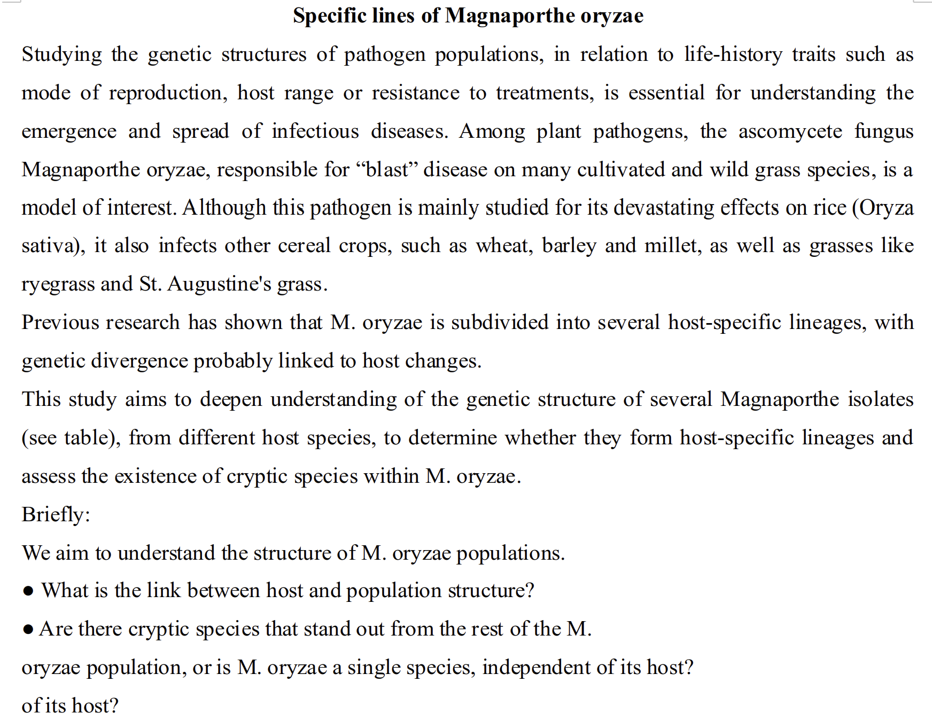
TOPIC
<numéro>

Slide 4
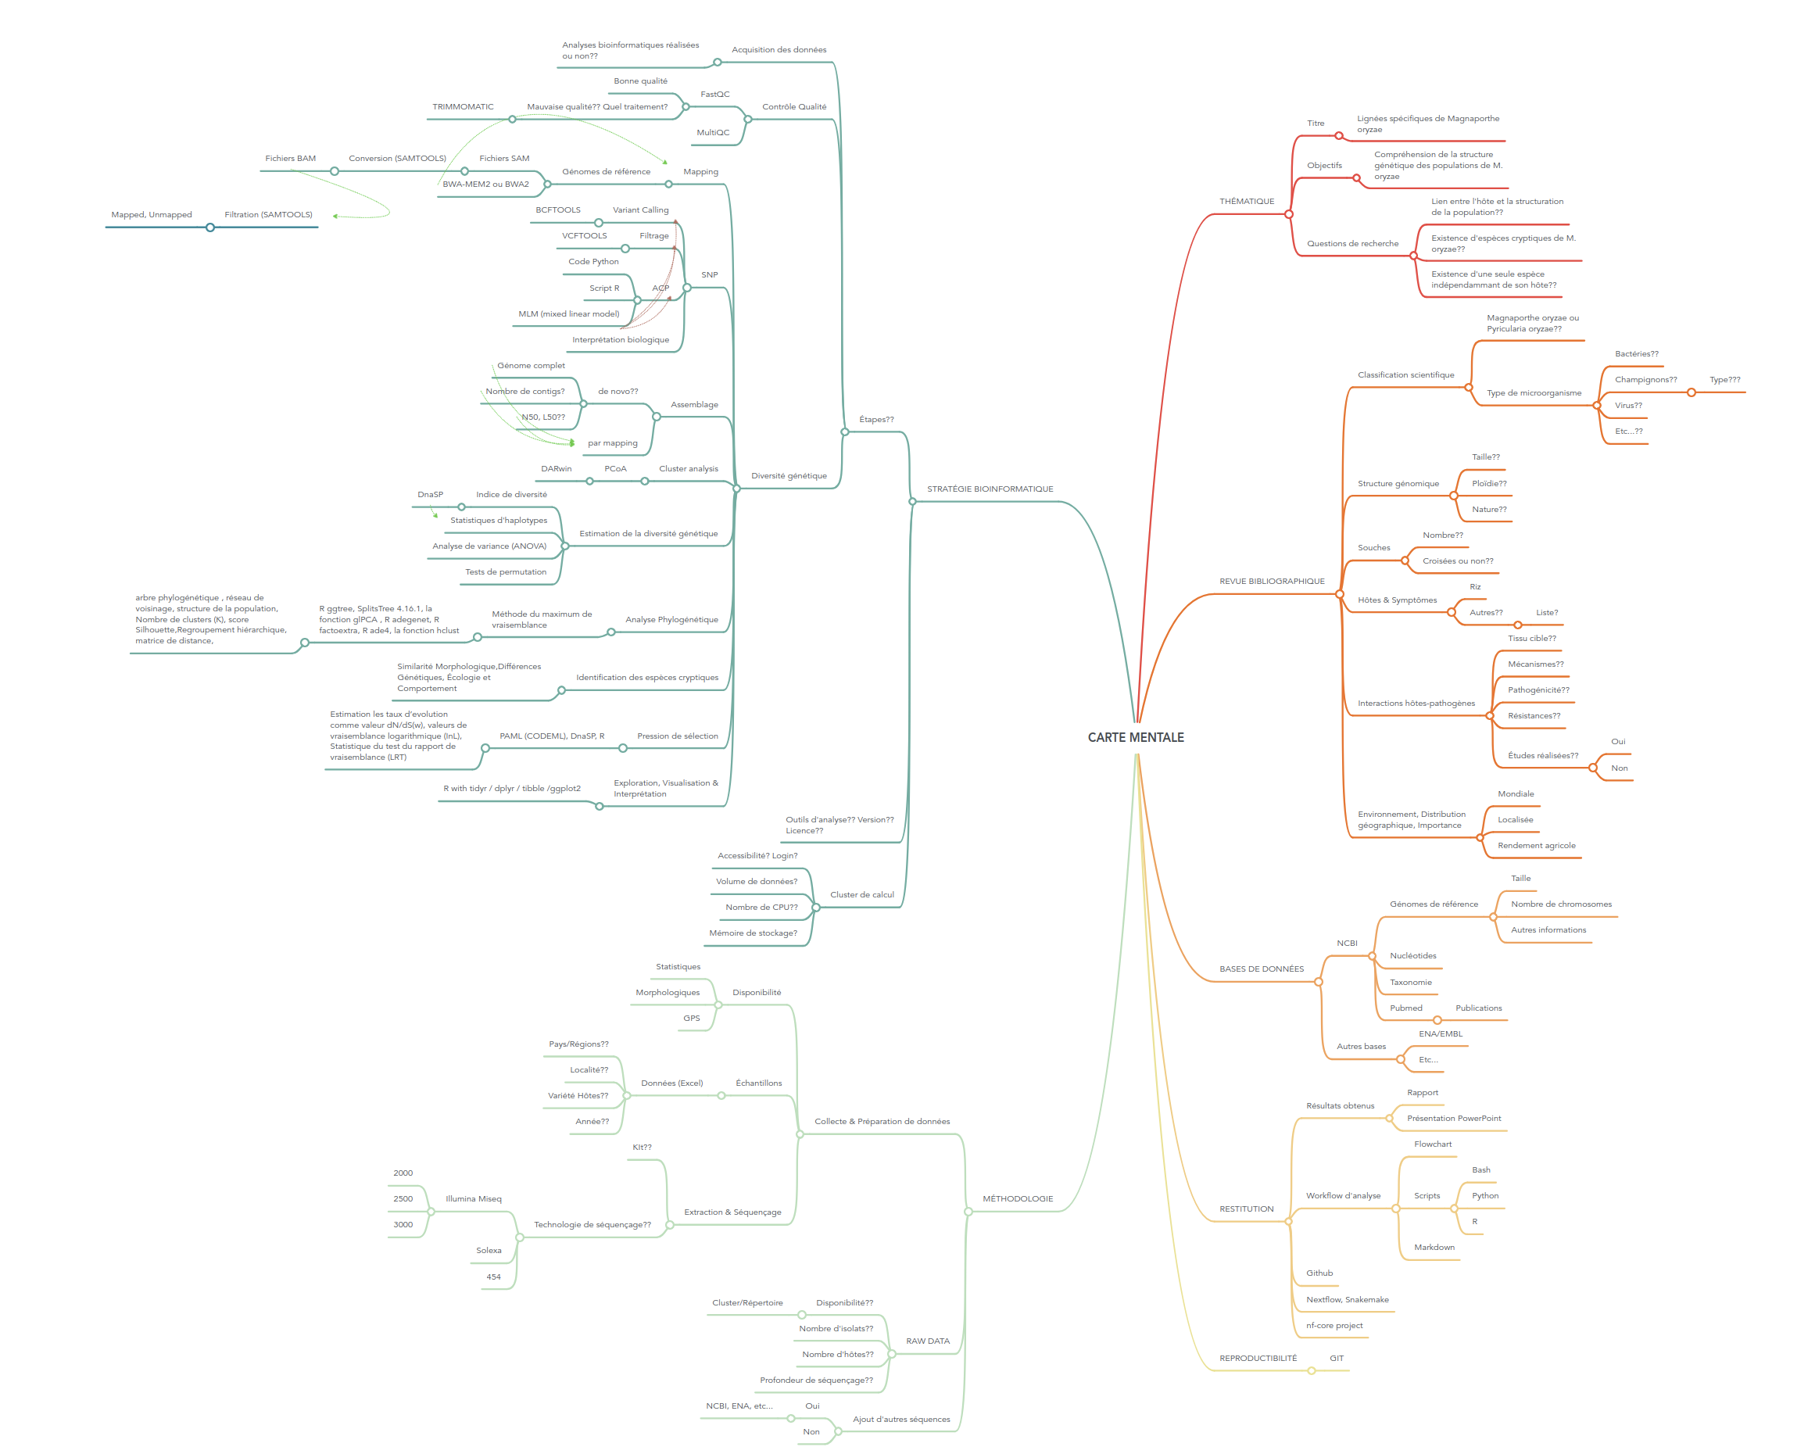

MIND MAP
<numéro>

Slide 5
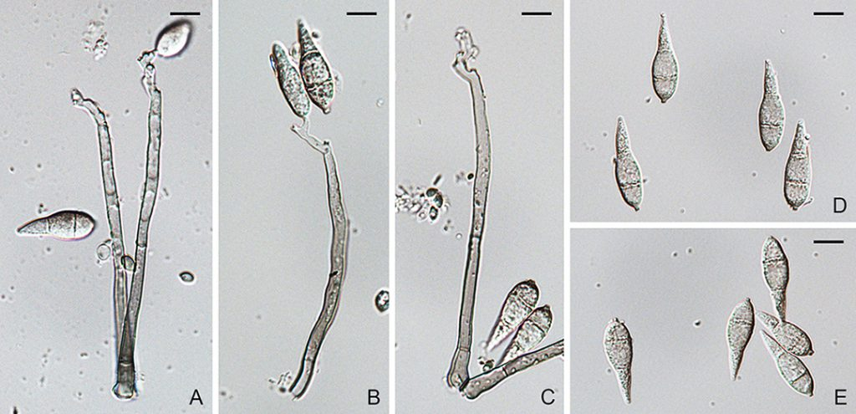
BACKGROUND (1/7)
TAXONOMY
- Kingdom: Fungi
- Phylum: Ascomycota
- Class: Sordariomycetes
- Order: Magnaporthales
- Family: Magnaporthaceae
- Genus: Magnaporthe
- Species: Magnaporthe oryzae (synonym of Pyricularia oryzae)
Pyricularia oryzae (181001p). A–E. Conidiophores and conidia
<numéro>

Slide 6
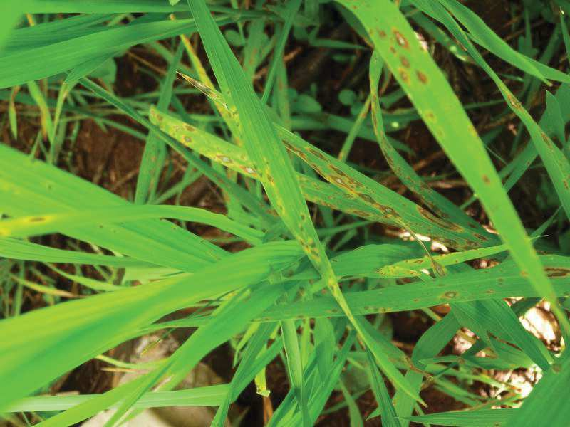
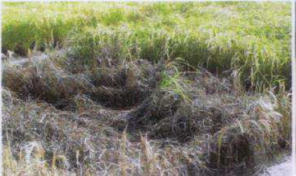
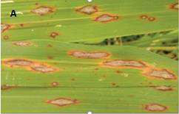
BACKGROUND (2/7)
Magnaporthe oryzae or Pyricularia oryzae, also known as rice blast fungus
one of the most important fungal disease of rice worldwide
Estimation: 10%–30% loss of rice production each year (Talbot, 2003)
Can infect the rice crop from seedlings to adult plant stages
Cause blast disease on more than 50 cultivated plant species
rice (Oryza sativa), wheat (Triticum aestivum), (Chiapello et al., 2015)
barley (Hordeum vulgare), ﬁnger millet (Eleusine coracana) etc.
Foliar blast on rice
Source : (M. Sester/Cirad)
Field damage in the Camargue. Photos: JB Morel, INRAE
Rice blast symptoms
Diallo, 2021
<numéro>

Slide 7
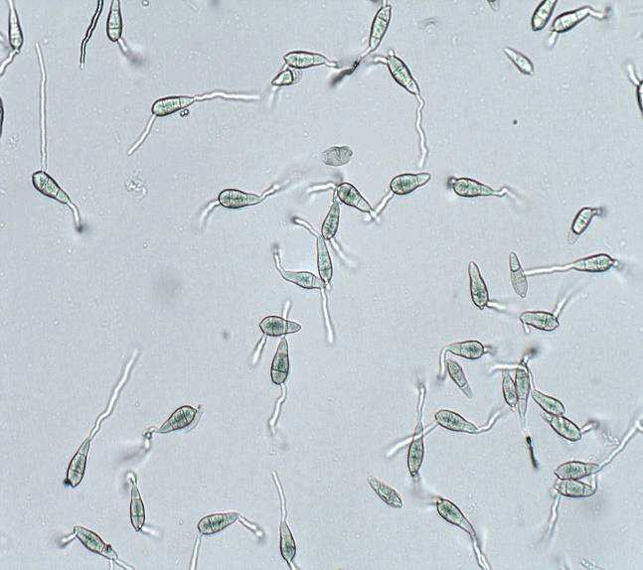
BACKGROUND (3/7)
M. oryzae is an ascomycete fungus, haploid
Can reproduce both sexually and asexually to produce specialized infectious structures (Kankanala et al., 2007)
Hemibiotroph which initially colonized in a biotrophic manner
Develops bulbous and branched hyphae that interfaces with the plant
And ﬁnally switches to a necrotrophic lifestyle
M. oryzae, ﬁrst plant pathogenic fungus to be completely sequenced
(Dean et al, 2005)
Germinated spores of M. oryzae under the miscroscope
(LEICA MA205 C) Photo : D. Diagne / BGPI CIRAD, Montpellier, 2020
<numéro>

Slide 8
BACKGROUND (4/7)
High genetic variation of M. oryzae was found in populations from
South, East and Southeast Asia,
which is more diverse than in other continents (Zeigler, 1998)
Study based on microsatellites markers supported this observation
Asia was the center of origin of M. Oryzae (Saleh et al., 2014)
Advances in high-throughput genomic sequencing have enhanced single
nucleotide polymorphism (SNP) discovery.
<numéro>

Slide 9
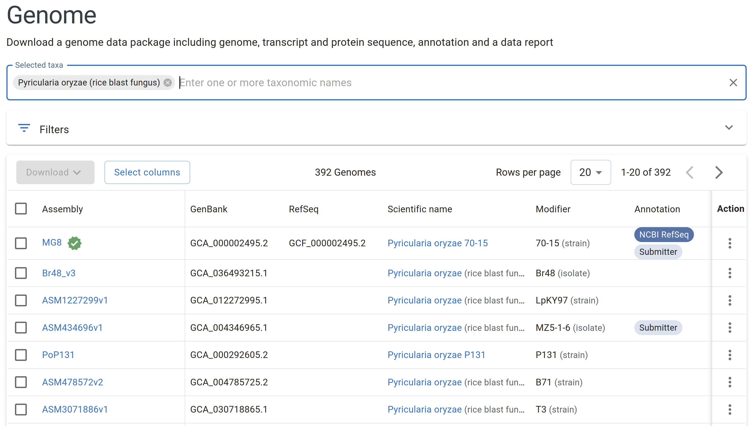
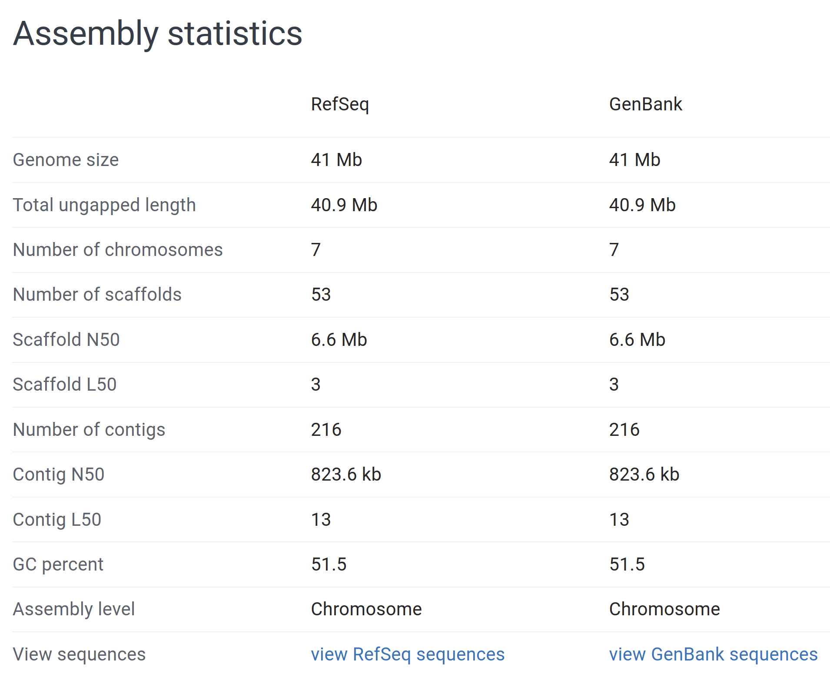
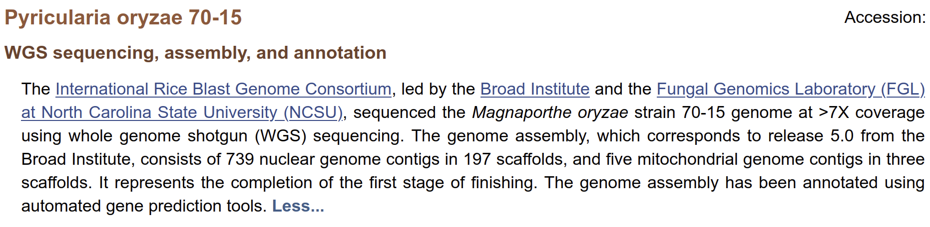
BACKGROUND (5/7)
<numéro>

Slide 10
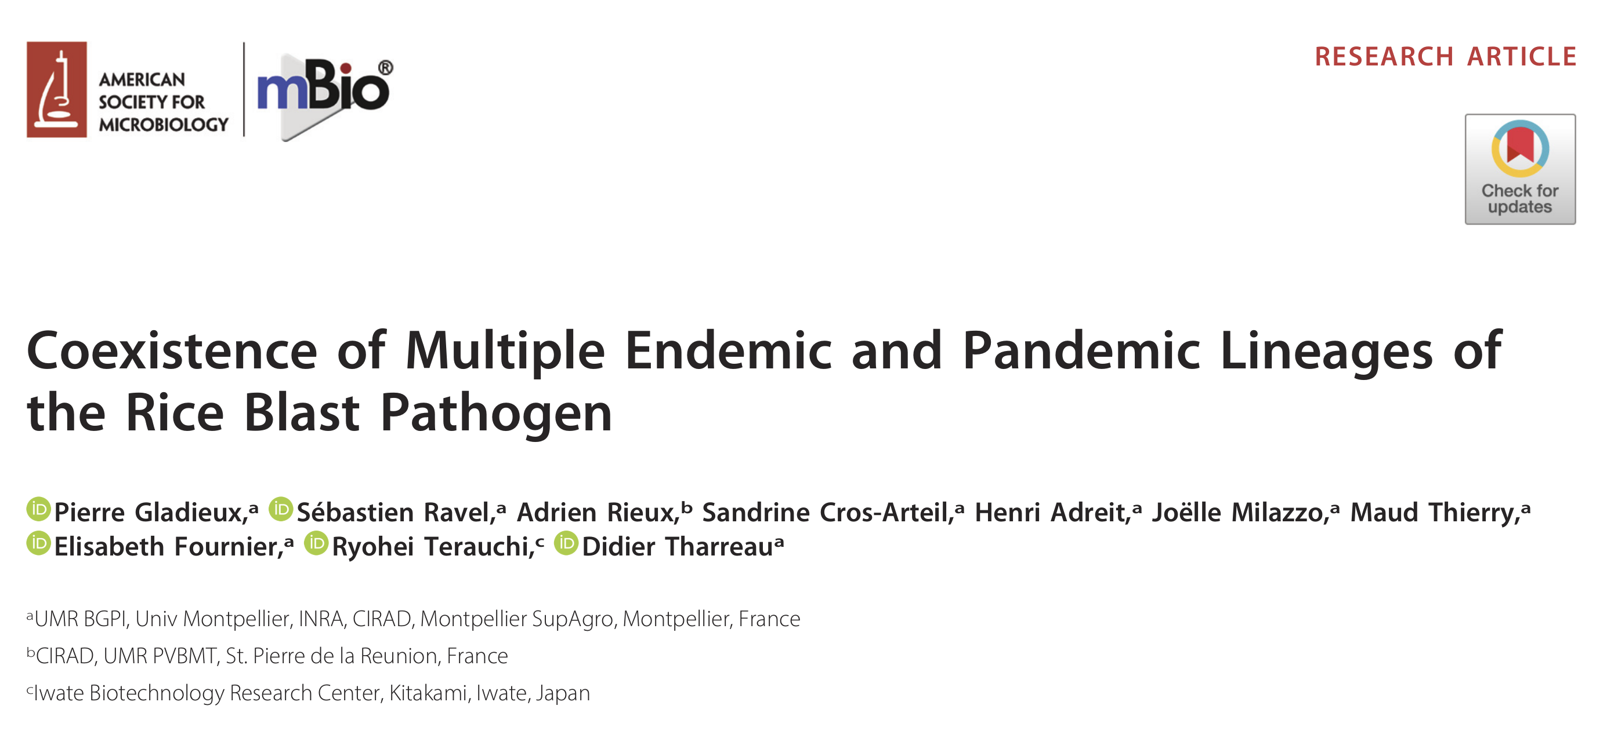
BACKGROUND (6/7)
<numéro>

Slide 11
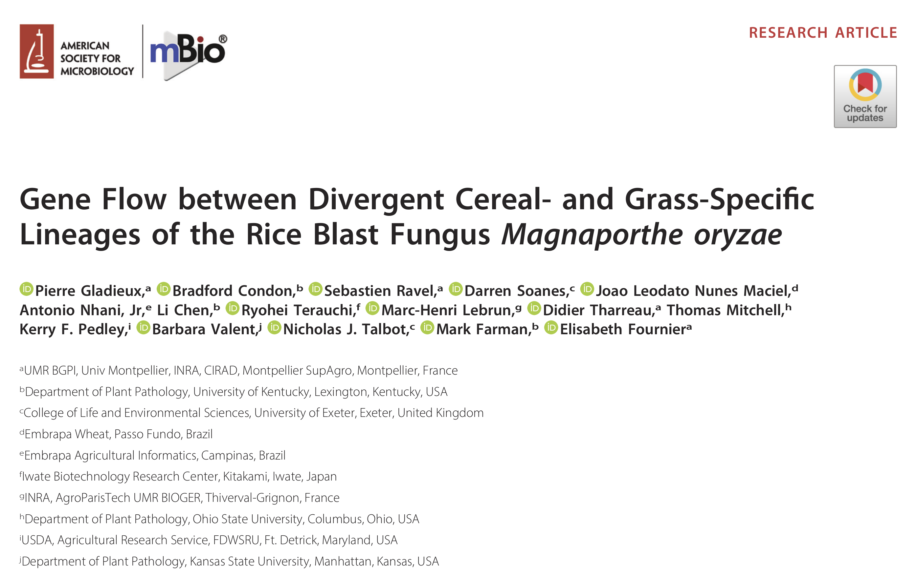
BACKGROUND (7/7)
<numéro>

Slide 12
OBJECTIVES
GENERAL
Understanding the structure of M. oryzae populations
SPECIFICS
Link between host and population structure
Existence of cryptic species that stand out from the rest of the M. oryzae population or
Existence of a single species, independent of its host
<numéro>

Slide 13
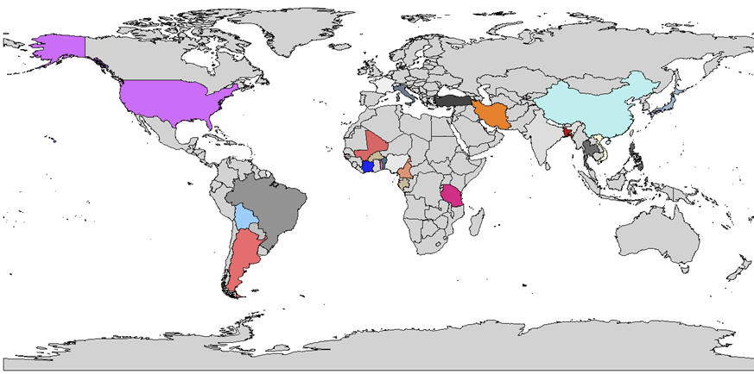
BIOINFORMATIC STRATEGY (1/5)
Isolates of study (1/2)
A total of 89 isolates from differents countries (25)
<numéro>

Slide 14
BIOINFORMATIC STRATEGY (2/5)
Isolates of study (2/2)
Data obtained for the project
Raw reads
Assembled sequences
List of isolates and their hosts
Assembly information
<numéro>

Slide 15
BIOINFORMATIC STRATEGY (3/5)
Sequencing startegy
Paired-end
Illumina (HiSeq, MiSeq)
Solexa & 454
Bioinformatics analysis platform
Montpellier cluster
Local machine
<numéro>

Slide 16
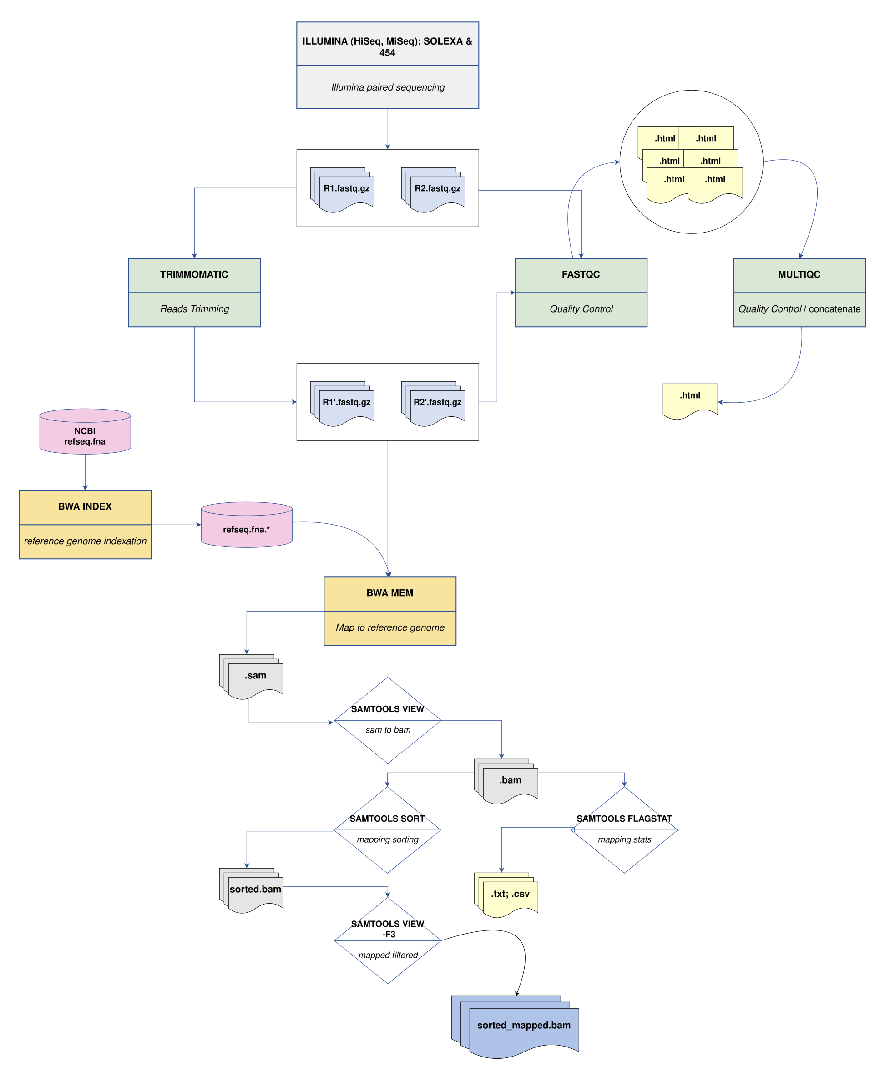
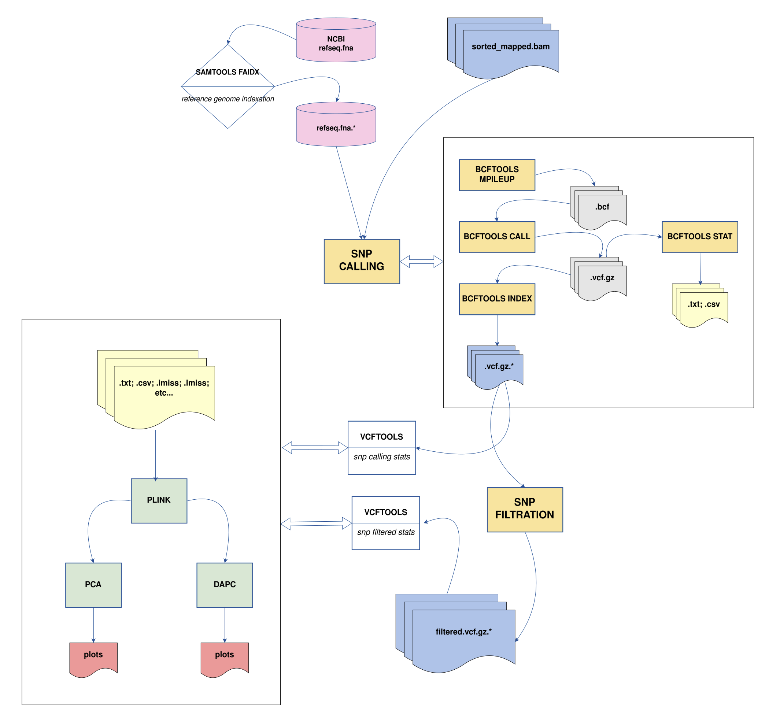
BIOINFORMATIC STRATEGY (4/5)
1
2
<numéro>

Slide 17
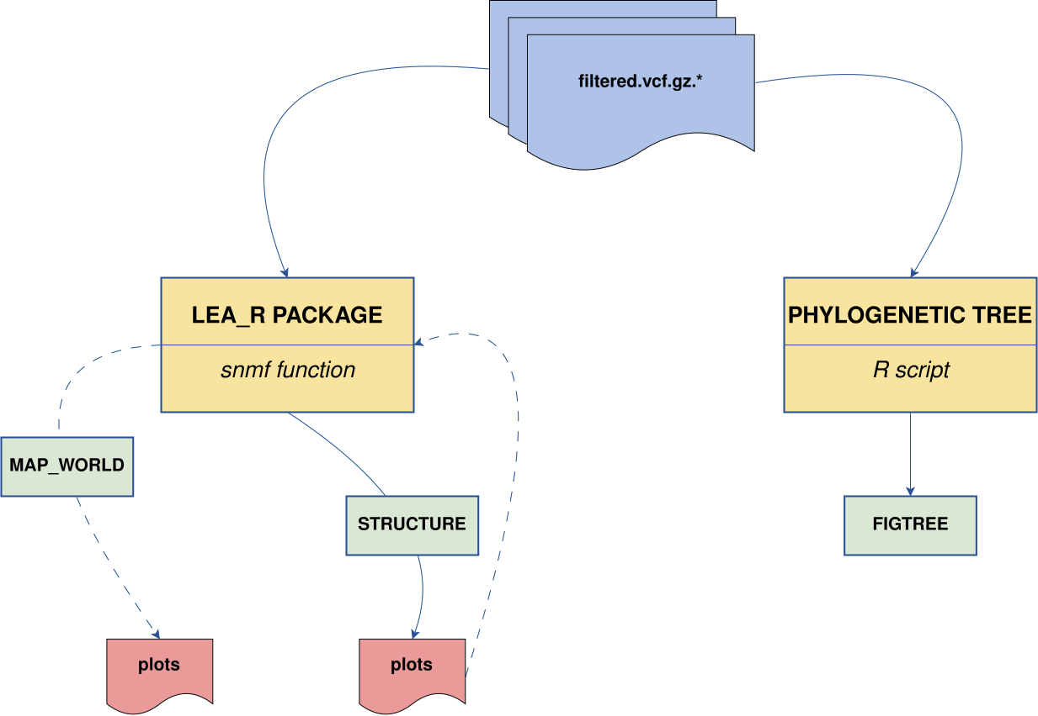
BIOINFORMATIC STRATEGY (5/5)
3
<numéro>

Slide 18
RESULTS & DISCUSSION (1/14)
QUALITY CONTROL (1/2)
Progressive decrease in read quality beyond 200 bases (towards the extremities)
reaching scores below 20, which is considered low
Quality problems (long reads, adapters, etc.)
Trimming to remove low-quality bases
<numéro>

Slide 19
RESULTS & DISCUSSION (2/14)
QUALITY CONTROL (2/2)
Consistently high quality scores over the entire length of the sequences.
Suggests higher-quality readings overall
<numéro>

Slide 20
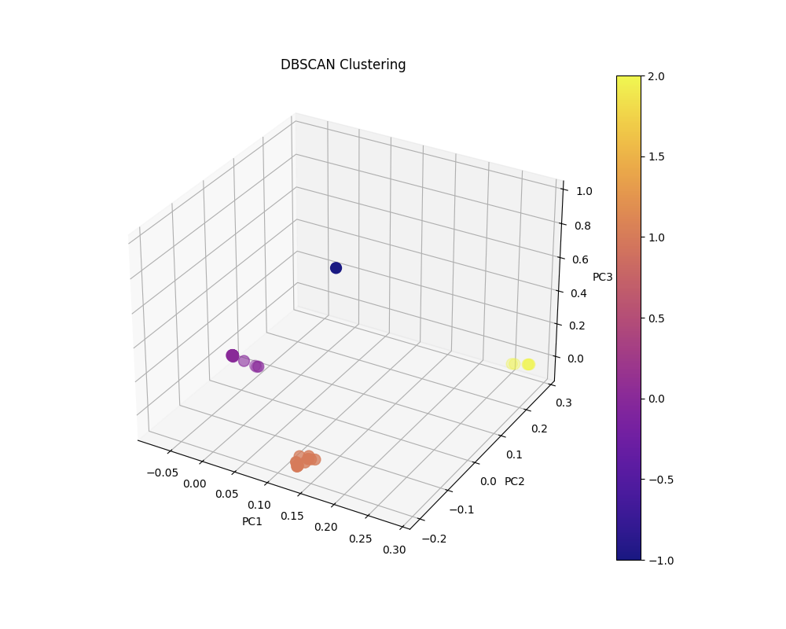
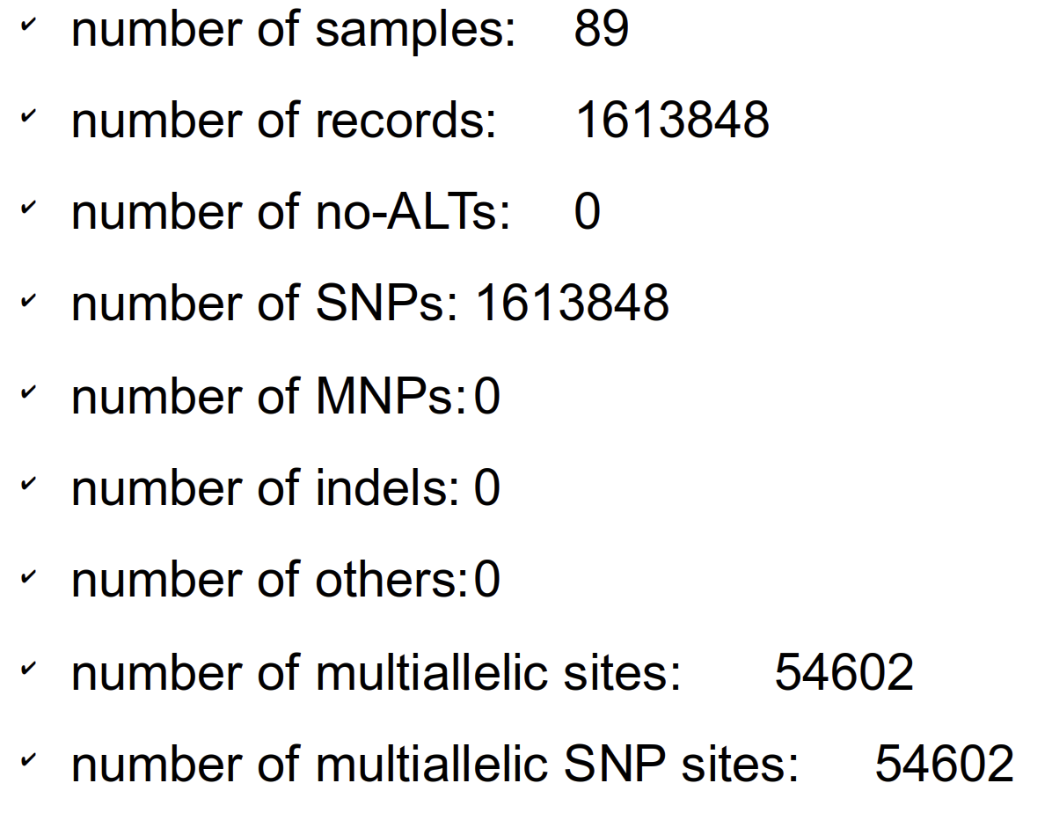
RESULTS & DISCUSSION (3/14)
SNP CALLING (1/5)
Stats & PCA
Three distinct clusters are visible.
The clusters are well separated, suggesting good differentiation between data groups.
<numéro>

Slide 21
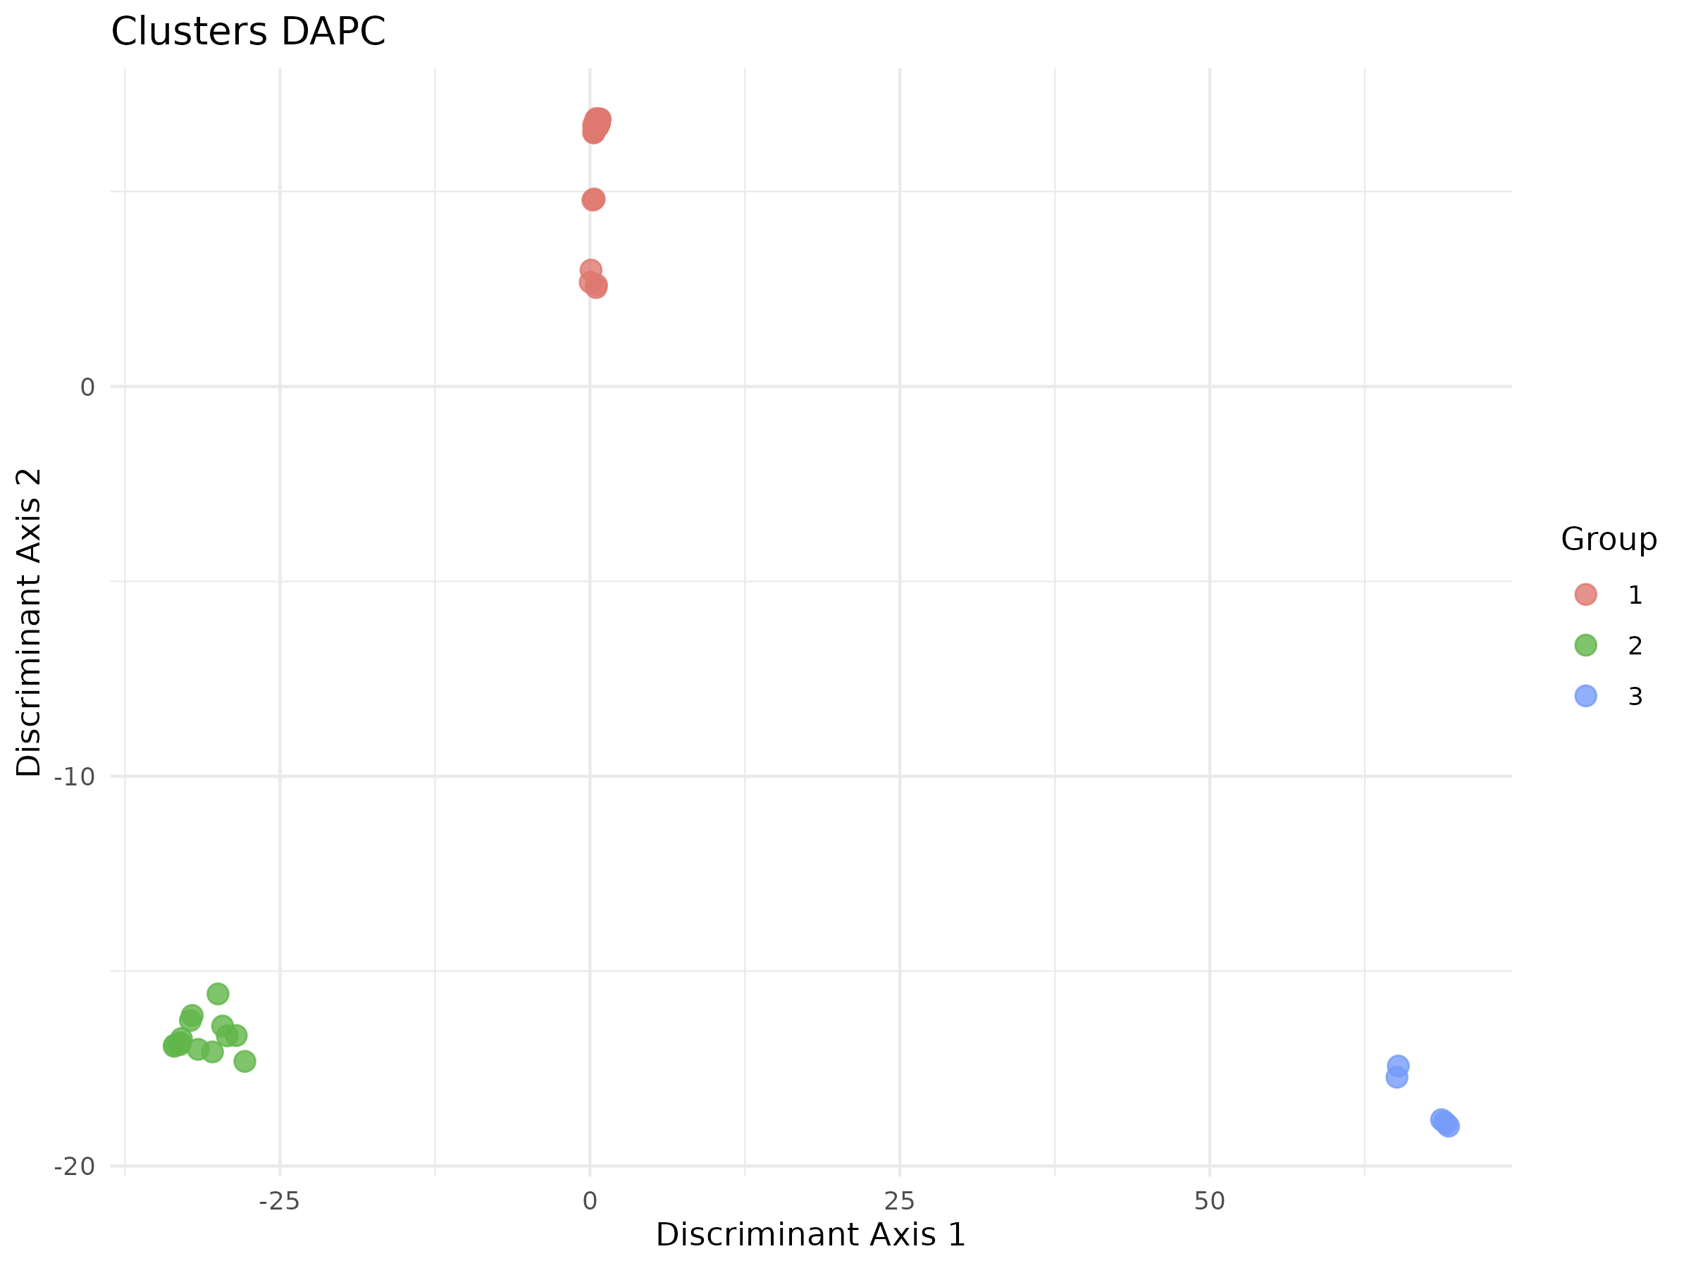
RESULTS & DISCUSSION (4/14)
SNP CALLING (2/4)
DAPC
Three distinct groups appear (red, green, blue).
The groups are well separated, but the red dots show greater dispersion than the others.
individuals of others groups share similar characteristics.
<numéro>

Slide 22
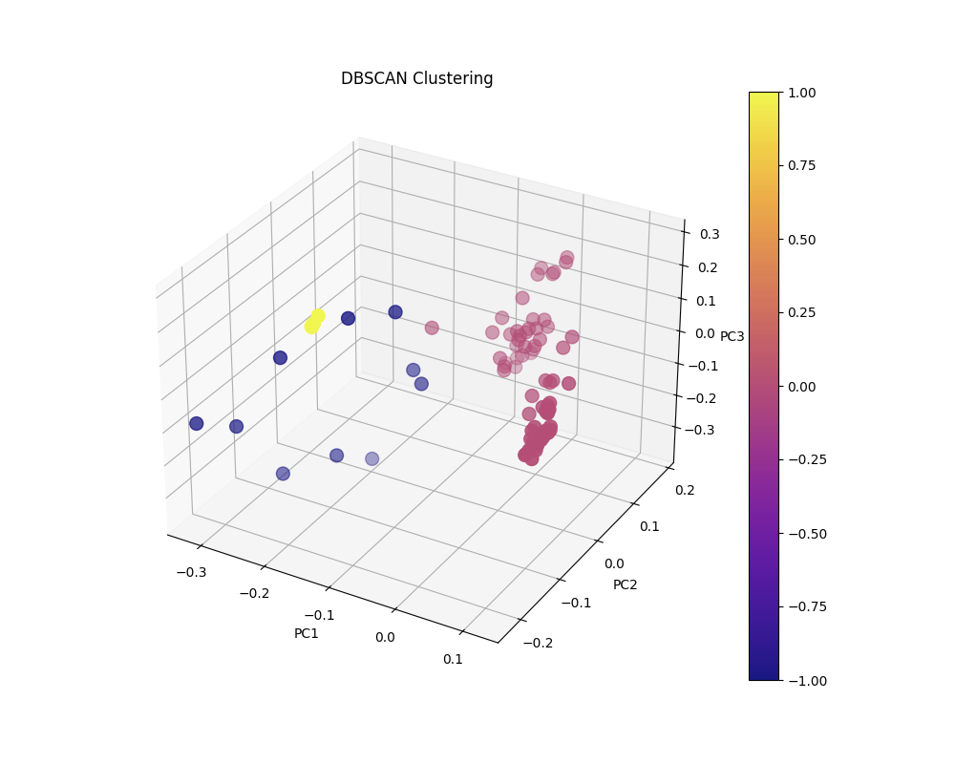
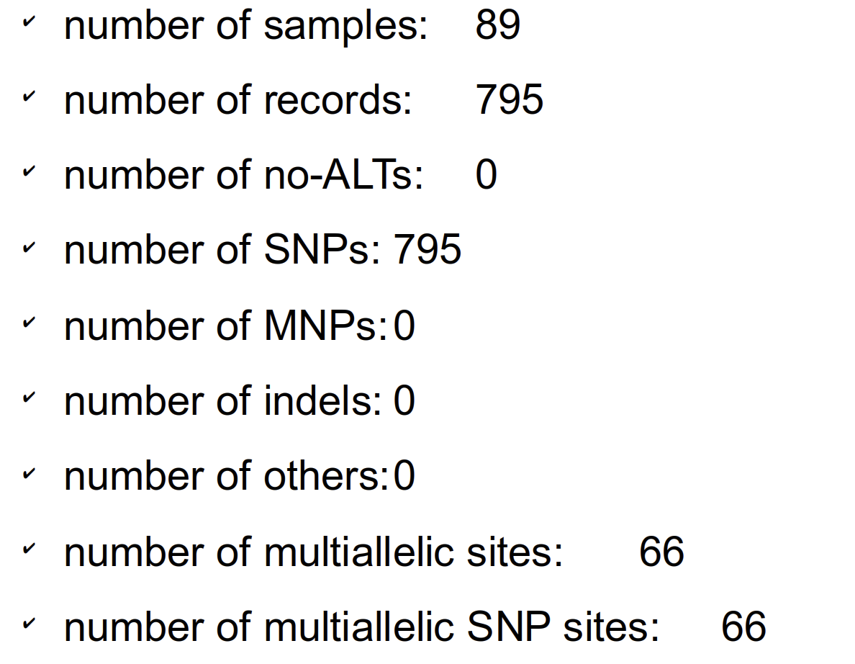
RESULTS & DISCUSSION (5/14)
SNP CALLING (3/4)
Stats & PCA
Three distinct clusters are always visible.
The clusters are well separated, suggesting considerable differentiation between the data groups.
In particular, the blue cluster
<numéro>

Slide 23
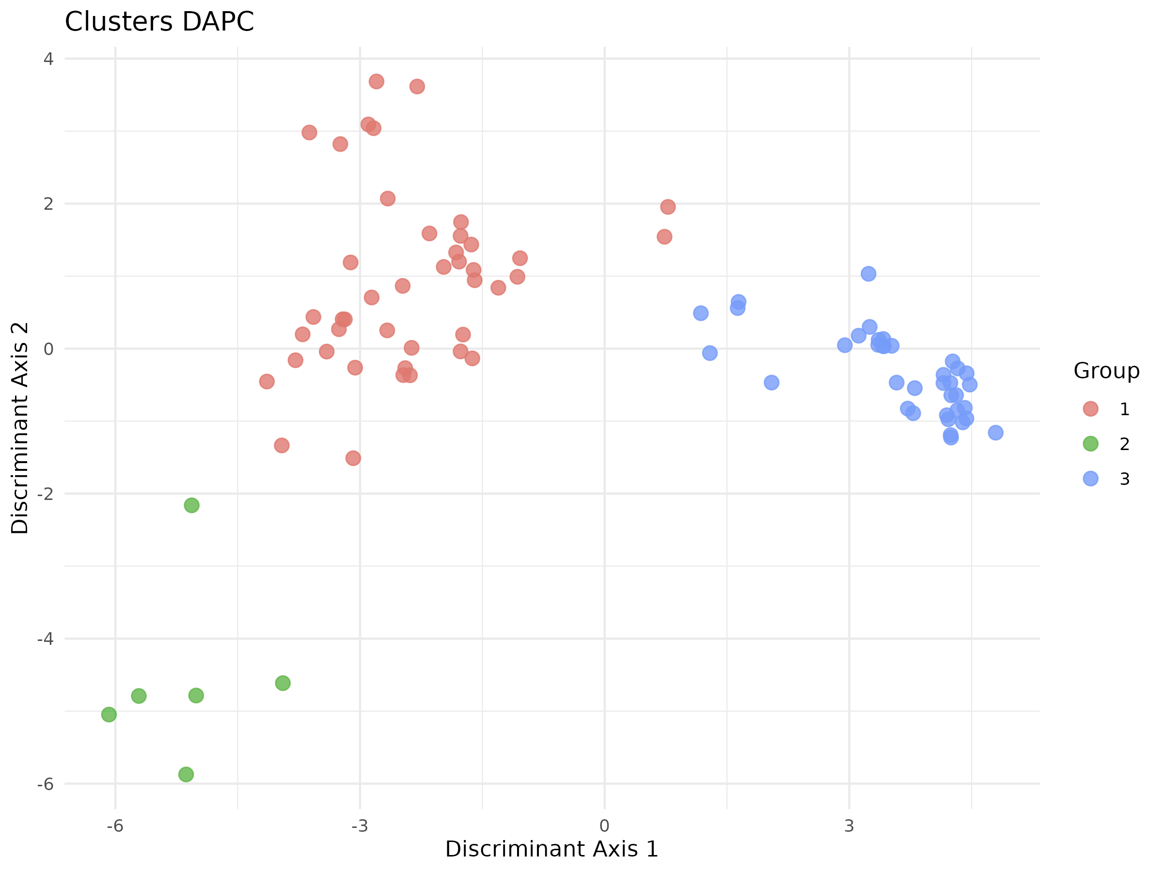
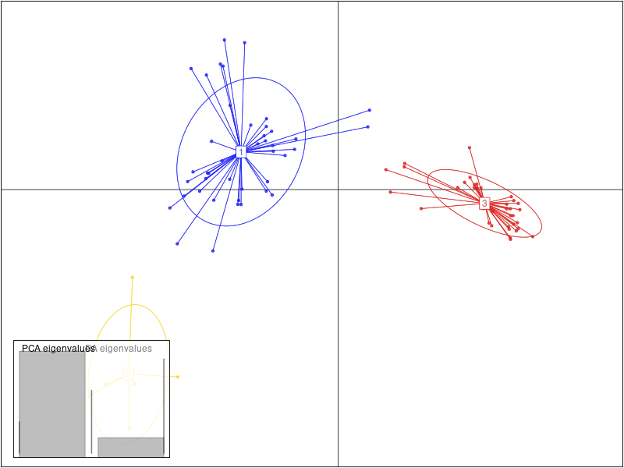
RESULTS & DISCUSSION (6/14)
SNP CALLING (4/4)
<numéro>

Slide 24
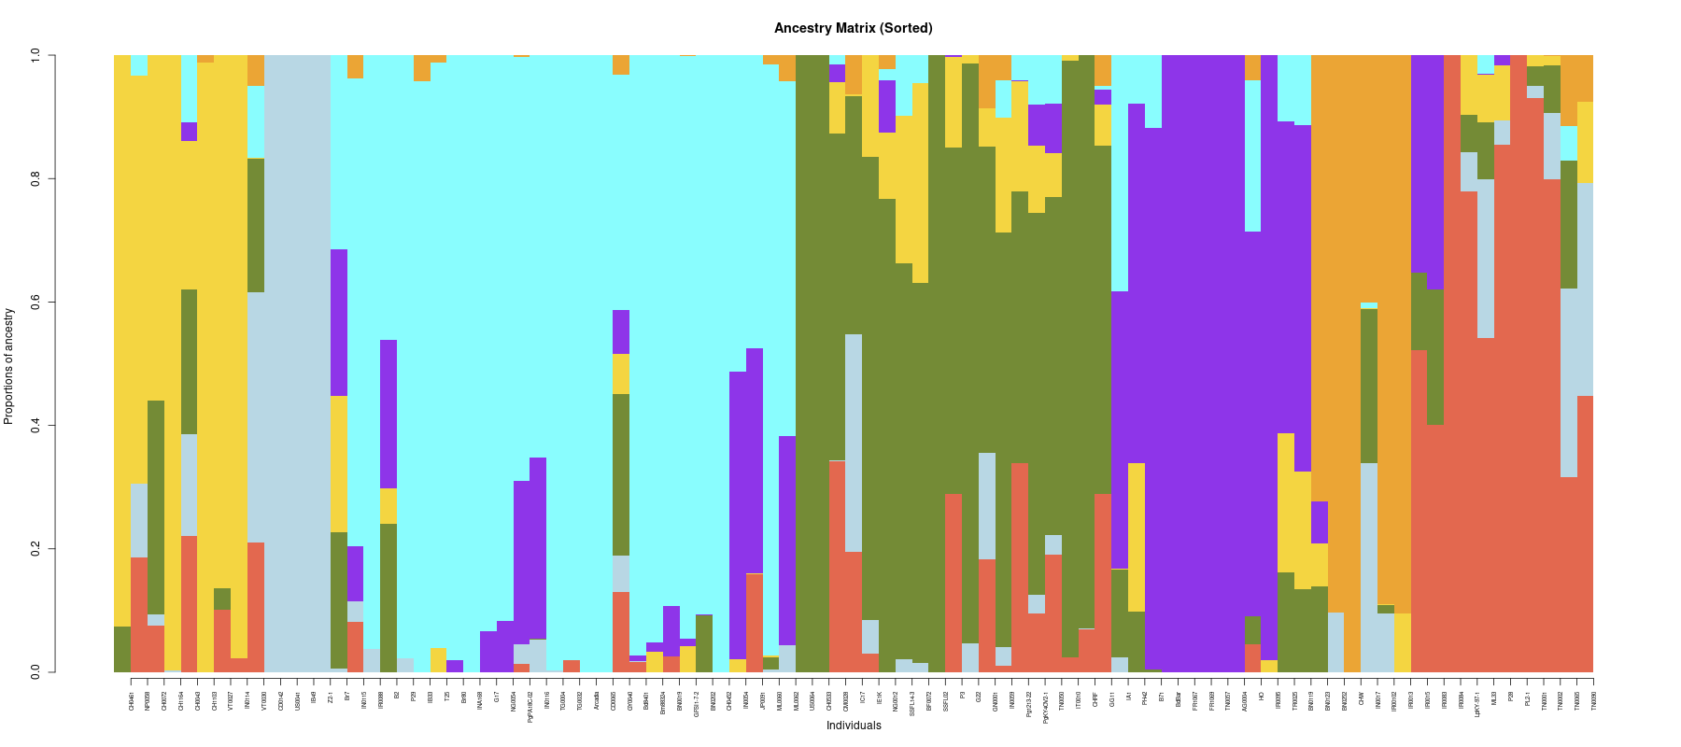
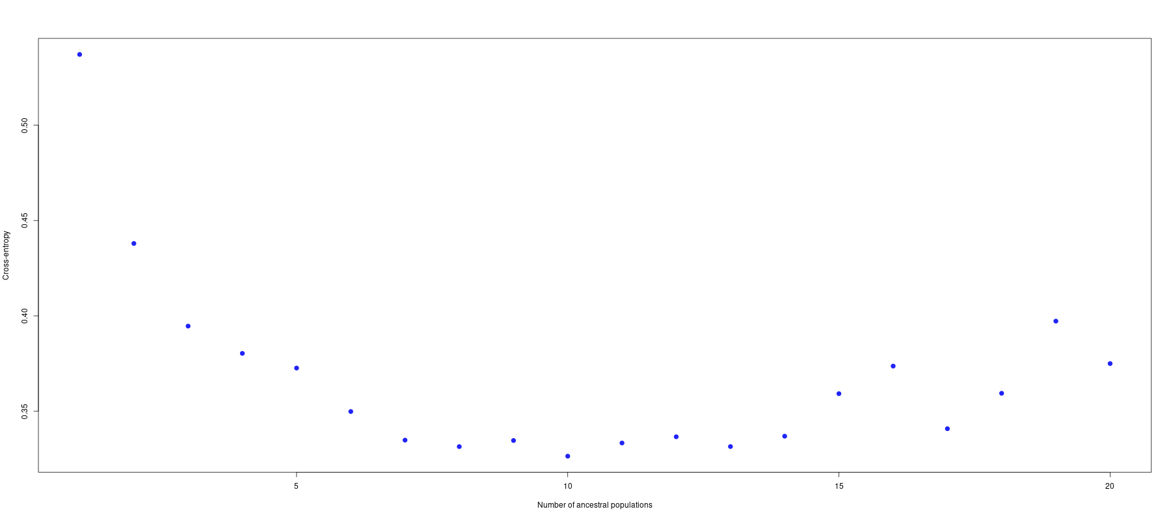
RESULTS & DISCUSSION (7/14)
GENETIC DIVERSITY (1/3)
Pop4
Pop7
Pop1 Pop2 Pop3 Pop4 Pop5 Pop6 Pop7
11 5 19 8 12 28 6
Pop2
Pop2
Pop6
Pop3
Pop5
Pop1
<numéro>

Slide 25
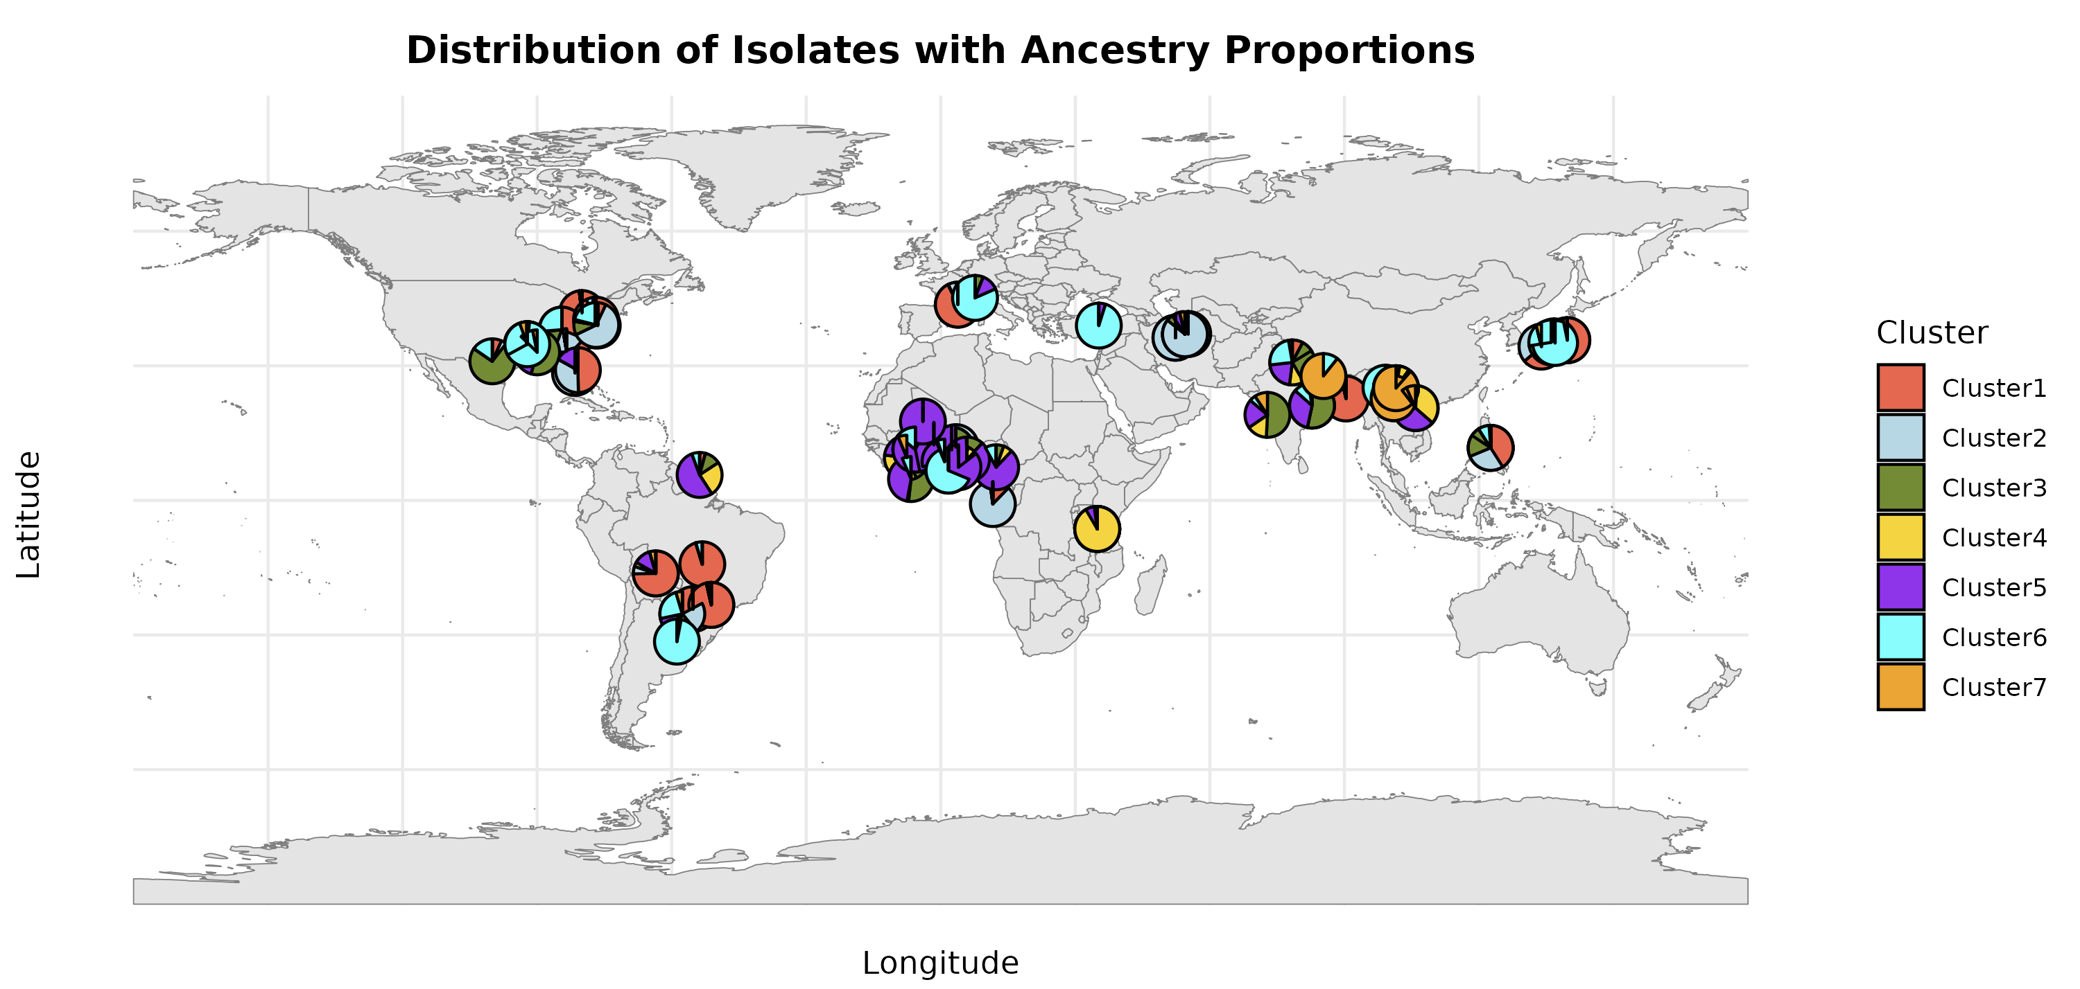
RESULTS & DISCUSSION (8/14)
GENETIC DIVERSITY (2/3)
<numéro>

Slide 26
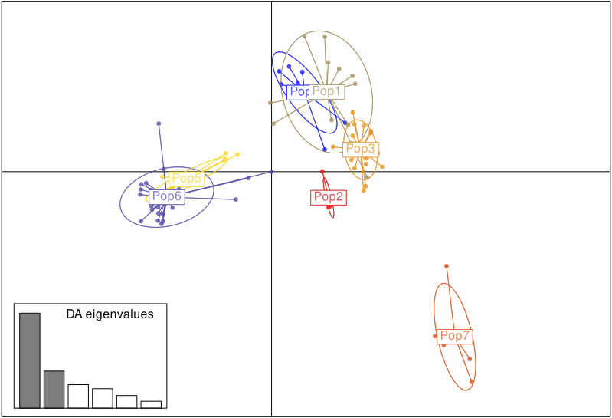
RESULTS & DISCUSSION (9/14)
GENETIC DIVERSITY (3/3)
The clusters are not well separated, suggesting similitude between data groups.
Except for Pop2 and Pop7, which are well separated from the other clusters, suggesting a difference, but homogeneity at the level of their individuals (Pop2).
Clusters (Pop5 and Pop6) are close or overlap: similarities between groups.
The same applies to clusters (Pop1, Pop3 and Pop4).
<numéro>

Slide 27
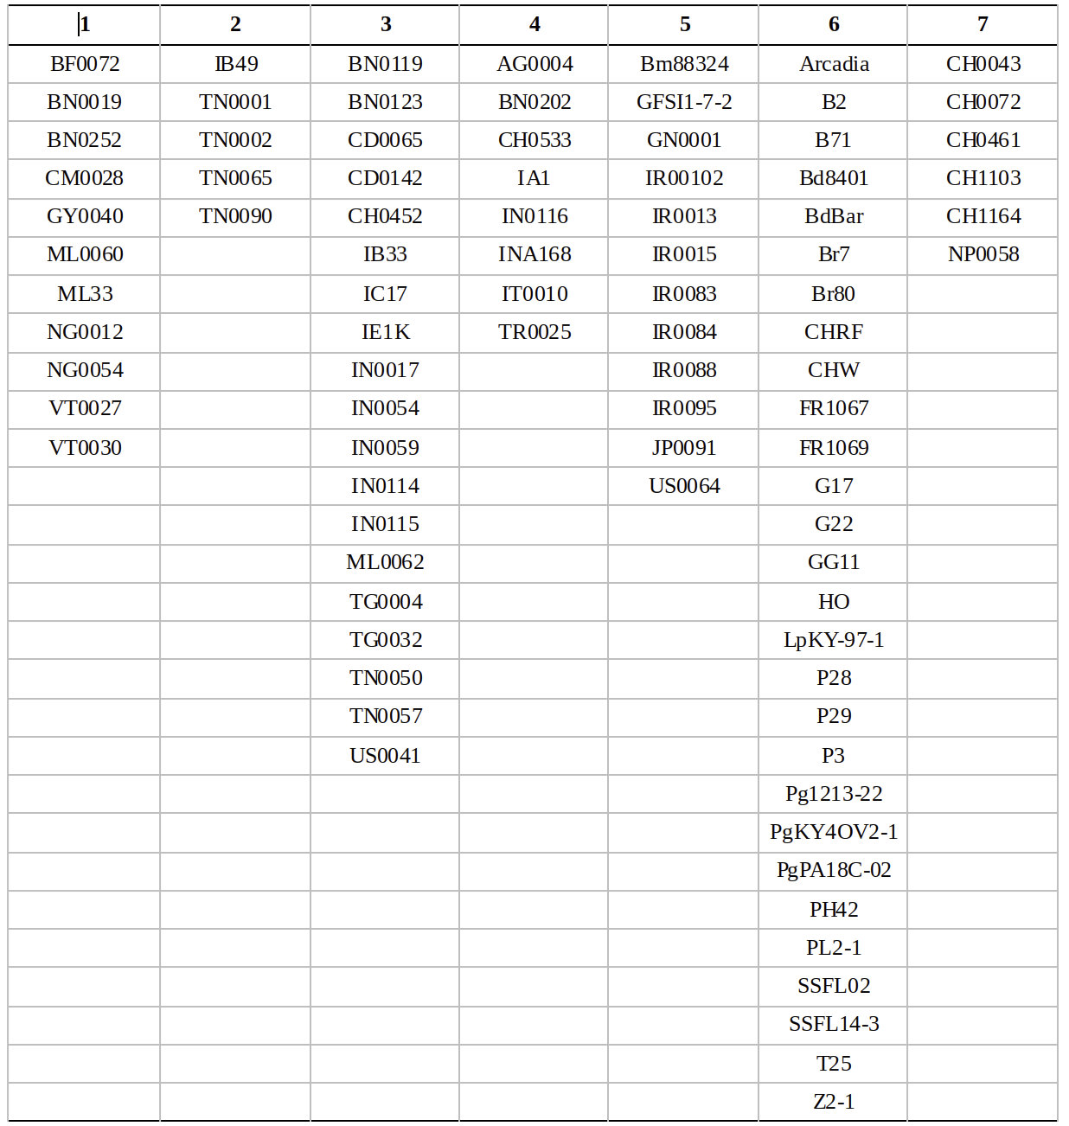
RESULTS & DISCUSSION (10/14)
PHYTLOGENETIC TREE
<numéro>

Slide 28
RESULTS & DISCUSSION (11/14)
Genetic diversity reduced among M. oryzae isolates
Correlation observed between pathogen and host, although relatively small
relatively small genetic differences between isolates remain
regardless of country of origin
Strong genetic proximity between rice isolates
Isolates from other hosts also tend to form distinct groups.
These observations suggest that the host plays a key role in structuring M. oryzae populations,
but with no marked separation between countries
<numéro>

Slide 29
RESULTS & DISCUSSION (12/14)
Our results are in accordance with several previous studies
showing that M. oryzae exhibits some host specialization,
although this is not a strict separation (Saleh et al., 2014; Gladieux et al., 2018).
The observed structuring, where isolates from Oryzae are genetically close, may be linked to specific adaptation to rice defense mechanisms, as shown in the work of Valent and Khang (2010).
<numéro>

Slide 30
RESULTS & DISCUSSION (13/14)
The absence of distinct genetic differences between isolates from different countries
can be explained by the movement of seeds and international trade,
favoring the dispersal of M. oryzae strains.
This hypothesis is supported by other studies
which highlight the global dispersion of pathogenic lineages through human activities (Takan et al., 2012).
<numéro>

Slide 31
RESULTS & DISCUSSION (14/14)
No cryptic species were detected in this study,
Other research has suggested the presence of cryptic subpopulations within M. oryzae (Latorre et al., 2020).
This could indicate greater complexity within pathogenic populations than our data currently reveal.
<numéro>

Slide 32
CHALLENGES
Lack of time for optimal management of different steps
limits the depth of certain analyses and the quality
New and complex topic to understand
considerable time for learning and experimentation
Multiplicity of research axes with SNPs
risk of dispersing efforts, potentially compromising the depth of priority analyses.
<numéro>

Slide 33
CONCLUSION (1/2)
Our results highlight a structuring of M. Oryzae populations
influenced mainly by the host, with moderate intra-population diversity
and an absence of significant geographic structuring.
These data reinforce the idea that pathogen management in crops
must take into account not only local dynamics but also international exchanges.
<numéro>

Slide 34

CONCLUSION (2/2)
The objective of this tutored project was achieved
Production of a Github page
(https://github.com/estelp/Mentoring_Project/tree/main)
Other aspects remain to be explored to better address objectives of this project
<numéro>

Slide 35
PERSPECTIVES
Explore other aspects of the study
Perform mapping
Optimize SNP filtering
Organize and improve the GitHub repository
Extend the project to produce a Snakefile
<numéro>

Slide 36
REFERENCES (1/2)
Chiapello, H., Mallet, L., Guérin, C., Aguileta, G., Amselem, J., Kroj, T., Ortega-Abboud, E., Lebrun, M.-H., Henrissat, B., Gendrault, A., Rodolphe, F., Tharreau, D., Fournier, E., 2015. Deciphering Genome Content and Evolutionary Relationships of Isolates from the Fungus Magnaporthe oryzae Attacking Different Host Plants. Genome Biol Evol 7, 2896–2912. https://doi.org/10.1093/gbe/evv187
Dean, R.A., Talbot, N.J., Ebbole, D.J., Farman, M.L., Mitchell, T.K., Orbach, M.J., Thon, M., Kulkarni, R., Xu, J.-R., Pan, H., Read, N.D., Lee, Y.-H., Carbone, I., Brown, D., Oh, Y.Y., Donofrio, N., Jeong, J.S., Soanes, D.M., Djonovic, S., Kolomiets, E., Rehmeyer, C., Li, W., Harding, M., Kim, S., Lebrun, M.-H., Bohnert, H., Coughlan, S., Butler, J., Calvo, S., Ma, L.-J., Nicol, R., Purcell, S., Nusbaum, C., Galagan, J.E., Birren, B.W., 2005. The genome sequence of the rice blast fungus Magnaporthe grisea. Nature 434, 980–986. https://doi.org/10.1038/nature03449
Gladieux, P., Ravel, S., Rieux, A., Cros-Arteil, S., Adreit, H., Milazzo, J., Thierry, M., Fournier, E., Terauchi, R., Tharreau, D., 2018. Coexistence of Multiple Endemic and Pandemic Lineages of the Rice Blast Pathogen. mBio 9, e01806-17. https://doi.org/10.1128/mBio.01806-17
Kankanala, P., Czymmek, K., Valent, B., 2007. Roles for rice membrane dynamics and plasmodesmata during biotrophic invasion by the blast fungus. Plant Cell 19, 706–724. https://doi.org/10.1105/tpc.106.046300
<numéro>

Slide 37
REFERENCES (2/2)
Latorre, S.M., Reyes-Avila, C.S., Malmgren, A., Win, J., Kamoun, S., Burbano, H.A., 2020. Differential loss of effector genes in three recently expanded pandemic clonal lineages of the rice blast fungus. BMC Biol 18, 88. https://doi.org/10.1186/s12915-020-00818-z
Saleh, D., Xu, P., Shen, Y., Li, C., Adreit, H., Milazzo, J., Ravigné, V., Bazin, E., Nottéghem, J.-L., Fournier, E., Tharreau, D., 2012. Sex at the origin: an Asian population of the rice blast fungus Magnaporthe oryzae reproduces sexually. Molecular Ecology 21, 1330–1344. https://doi.org/10.1111/j.1365-294X.2012.05469.x
Takan, J.P., Chipili, J., Muthumeenakshi, S., Talbot, N.J., Manyasa, E.O., Bandyopadhyay, R., Sere, Y., Nutsugah, S.K., Talhinhas, P., Hossain, M., Brown, A.E., Sreenivasaprasad, S., 2012. Magnaporthe oryzae populations adapted to finger millet and rice exhibit distinctive patterns of genetic diversity, sexuality and host interaction. Mol Biotechnol 50, 145–158. https://doi.org/10.1007/s12033-011-9429-z
Talbot, N.J., 2003. On the Trail of a Cereal Killer: Exploring the Biology of Magnaporthe grisea. Annual Review of Microbiology 57, 177–202. https://doi.org/10.1146/annurev.micro.57.030502.090957
Valent, B., Khang, C.H., 2010. Recent advances in rice blast effector research. Curr Opin Plant Biol 13, 434–441. https://doi.org/10.1016/j.pbi.2010.04.012
Zeigler, R.S., 1998. RECOMBINATION IN MAGNAPORTHE GRISEA. Annual Review of Phytopathology 36, 249–275. https://doi.org/10.1146/annurev.phyto.36.1.249
<numéro>

Slide 38
THANKS
<numéro>

